Slide 1

Wifi Pineapples
The sweet and the sour

Slide 2
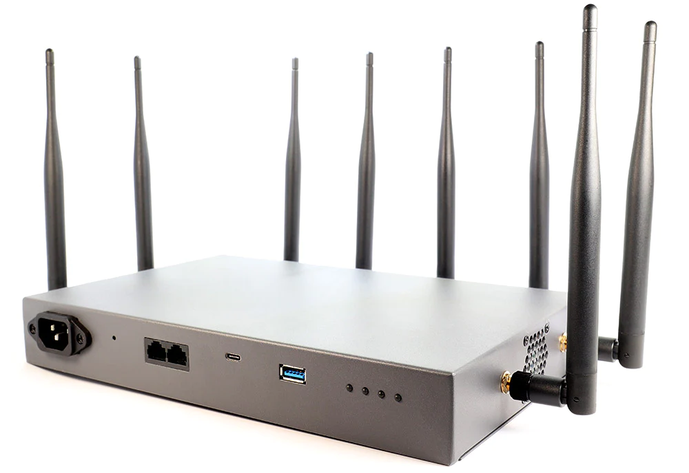
What is it?
Tool used for Penetration Testing
Meant to exploit WiFi vulnerabilities
Notes:
What is a wifi pineapple? Scary looking thing over there
Why is it called a pineapple? Because of the spooky antennas jutting out of it. Really. That’s it. Not the most creative naming
The pineapple pictured above is the official Hak5 one, it goes for anywhere from 900 - 2700. Hak5 initially developed these for penetration testing. Can be used to monitor network traffic, scan the network it’s connected to, and do wifi osint. Unsecured Cameras

Slide 3
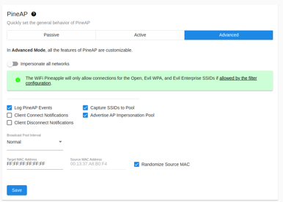
Provides a simple, easy to use GUI
Has additional modules
Comes with a built in report compiler
Notes:
Why is the Hak5 wifi pineapple so nice? The biggest difference is that instead of working in the command line, it has its own graphical interface. This not only makes it easy to use but fast for professional pentesting. You can quickly navigate the menus and see the effects in real time. Suppose I’m scanning a network and trying to sniff out all access points, it's much simpler for me to do with a ui. Many quality of life improvements. Really obvious when you think of the intended purpose

Slide 4
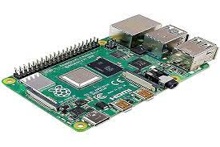
Our Homemade Pineapple
$35
Can do (most) everything a commercial pineapple can do
Notes:
I want you to compare the Hak5 Pineapple with this little DIY version. Now, depending on what you want to do with it, the setup can range from compilated to impossible. BUT - nearly everything an official wifi pineapple can do a raspberry pi can do too. The Pros: Cheaper, much more customizable (you really can do pretty much anything with a raspberry), and just in general more software support. Cons: SO much harder to setup. No Gui (which makes a big difference, trust me), Wifi connection is noticeably worse.

Slide 5
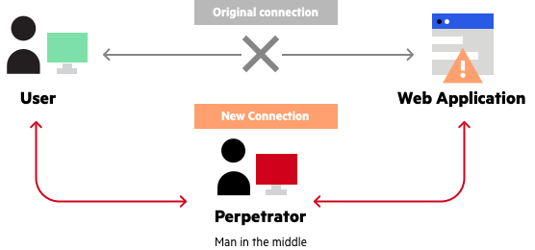
Man in the middle attacks
Umbrella term for when an attacker is positioned between the user and their application
IP spoofing
ARP spoofing/poisoning
DNS poisoning
Notes:
Man in the middle attacks are a type of attack where the threat actor is between the user and the user’s intended connection. That’s it. It can be applied to anything from wifi hacking to web pages. Some Man in the middle attacks: Ip spoofing, where the attacker mimics a user’s ip by sending a forged ip packet. Wont go into detail about that because networks are too complicated
ARP spoofing. Where an attacker mimics a user’s mac address
DNS poisoning. Where an attacker alters the information in the cache on your device/web browser. You then get redirected to a malicious site. A lot of sketchy websites or phishing attacks start this way. Also why we dont click on sketchy links.

Slide 6

Evil Twin Attack
Attacker makes a fake access point
All network data is readable by attacker once victim is connected
Notes:
This is the one we’re going to be covering today. We’re going to be getting in between a user who’s trying to connect or is connected to a public wifi, and making them connect to ours instead. They won’t suspect a thing, but we’ll be able to see all of their network traffic. I can see where they go, what information they enter. Etc. Evil twin attacks are scary bc while a netwrok provided like starbucks can prevent against other types of attacks on their network, an evil twin attack is between you and the victim. No countermeasures by the wifi provider can be taken

Slide 7
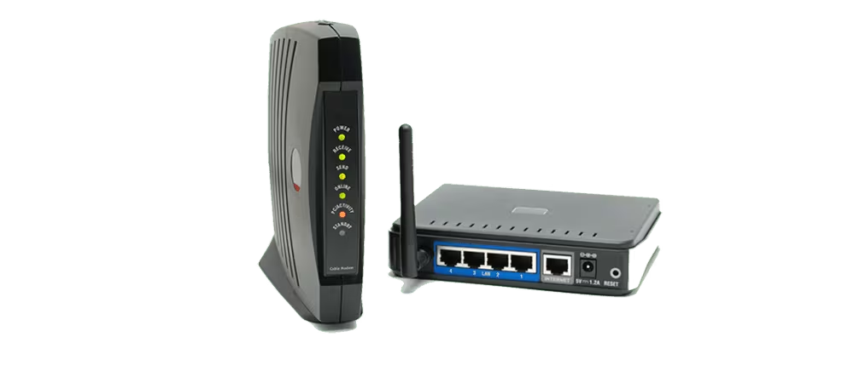

Notes:
In a regular connection, the user would connect to the wireless network/router. With our pineapple, we’re going to spoof the SSID (network Service Set Identifier) and make a new connection to our device instead of the intended network. Once they’re connected it over. We’re specifically exploiting a “feature” with most wifi adapters that if there exist two networks with the same SSID, it will connect to the one stronger. (wont work for mine bc my adapter is on its last legs) Therefore if we’re closer to our victim we can provide better connection than the router, and make their device switch to ours.

Slide 8
Demo!

Slide 9
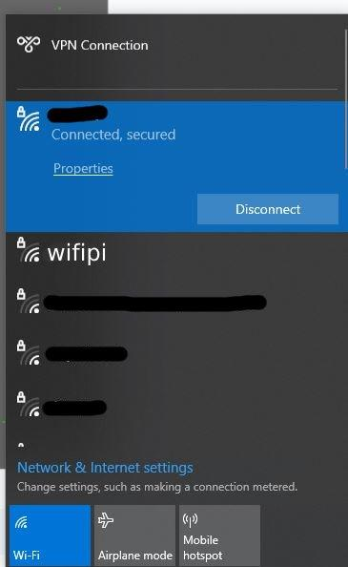
Demo! (adapter being silly)
Victim would see our network, wifipi
They would connect to it, and have no idea that anything was wrong with it
Notes:
Wifi adapter being silly, I figured it would happen (which is why i have these slides!)
The next step is simply for our victim to connect to the fake wifi, wifipi. Network still functions like normal, since we have our pineapple acting as a bridge with dhcpcd.conf
Again, remember that if i were hypothetically in a starbucks or smth, and named my SSID “Starbucks”, anyone on that wifi that had a stronger connection to me would switch over to mine.

Slide 10
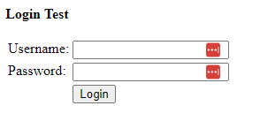
We can see the victim’s traffic
Can also perform a dns poisoning attack with redirects
Notes:
Since we have dnschef working as well, we can do some redirects.

Slide 11

How Do I Prevent This?
Don’t connect to public WiFi. Just because it’s named Starbucks doesn't mean it actually is.
Use a VPN
Notes:
Use the example of hotel wifi commonly being a pineapple in worse hotels. VPN encrypts, making evil twin attacks not be able to read your traffic.

